Slide 1
Unit Testing With a focus on practical topics
Student: Aryan Ebrahimpour
Professor: Saeed Zahedi

Slide 2



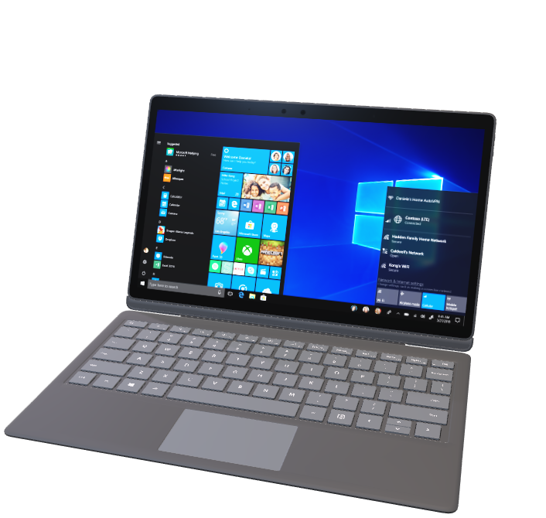


Table of Contents
Theoretical
A basic intro to Unit Testing
Practical
Basic examples
Real world examples
BDD
Btittle/Fragile Test
References

Slide 3
Theory
Lets read some about Unit Testing

Slide 4

A Basic Intro to Unit Testing
White box
Individual modules are tested
Checks if there are any issues by the Developer himself
Isolate each unit of System
Purpose: Identify, Analyze and Fix the defects

Slide 5
Practical
Lets see some basic examples

Slide 6
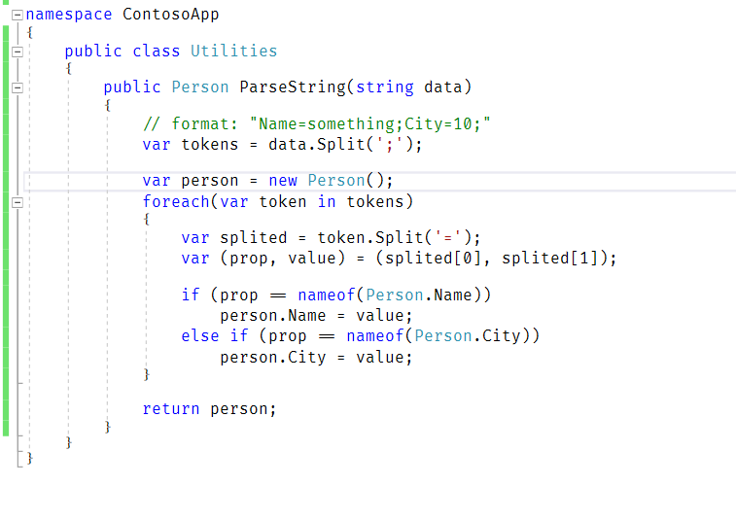
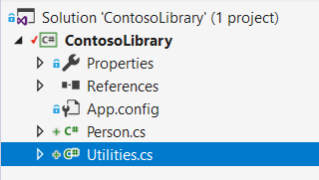
Basic Examples (1), The Code

Slide 7
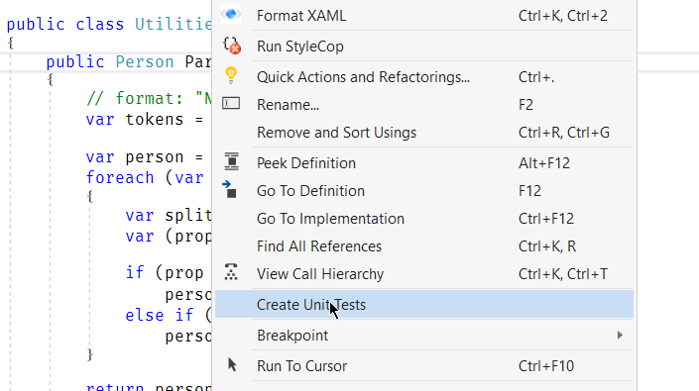
Basic Examples (2), Create Unit Test Project

Slide 8
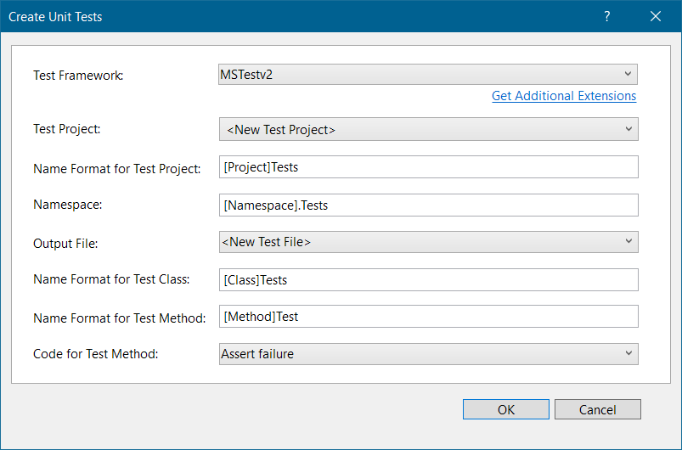
Basic Examples (3), Select Framework and Template

Slide 9
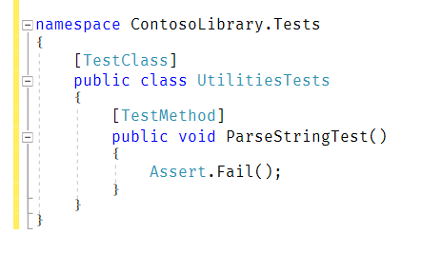
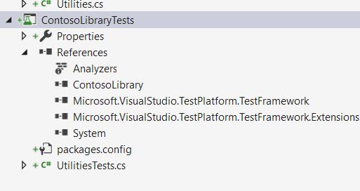
Basic Examples (4), Generated Test Project

Slide 10
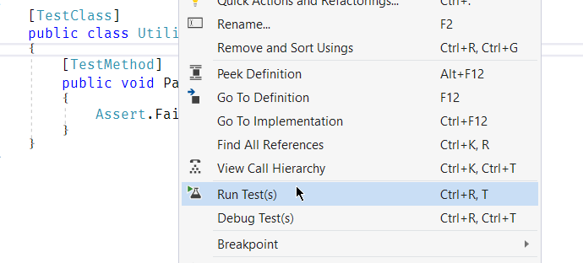
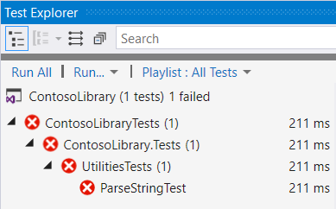
Basic Examples (5), Run Empty Test

Slide 11
Basic Examples (6), What to write?
What should we write in this method?

Slide 12



Basic Examples (7), What to write?
Let’s use the AAA Pattern,
Which basically means:
Arrange
Act
Assert

Slide 13
Basic Examples (8), What to write?
Arrange: initializes objects and sets the value of the data that is passed to the method under test.
Act: invokes the method under test with the arranged parameters
Assert: verifies that the action of the method under test behaves as expected

Slide 14
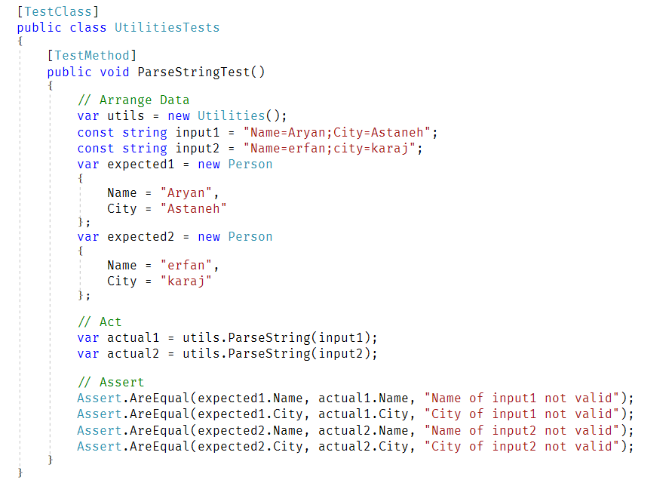

Slide 15
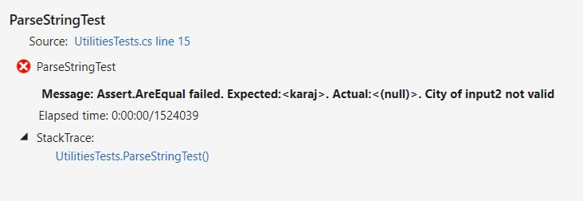
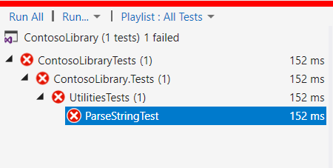
Basic Example (10)
Let’s check the result:
Hmmm… Makes sense!
Again no! But why?

Slide 16
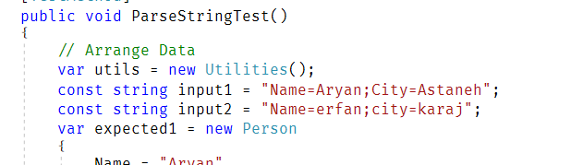
Basic Example (11)
Problem lies here:
Let’s fix it in the code

Slide 17
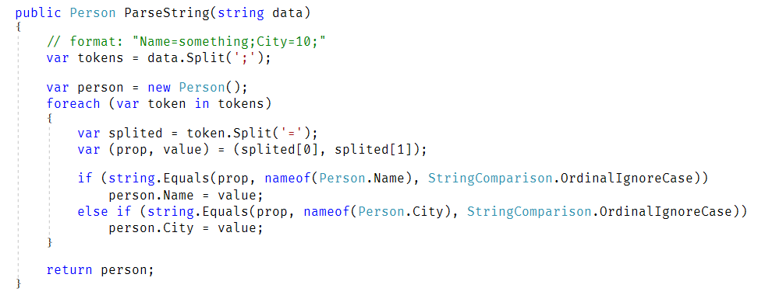
Basic Example (12)

Slide 18
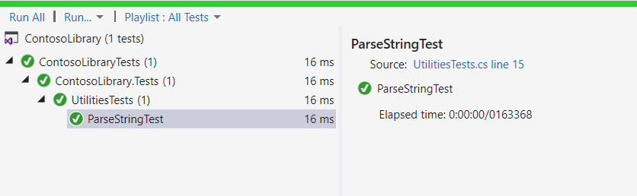
Basic Example (13)
Let’s check the result one more time:
The result is: A happy programmer

Slide 19
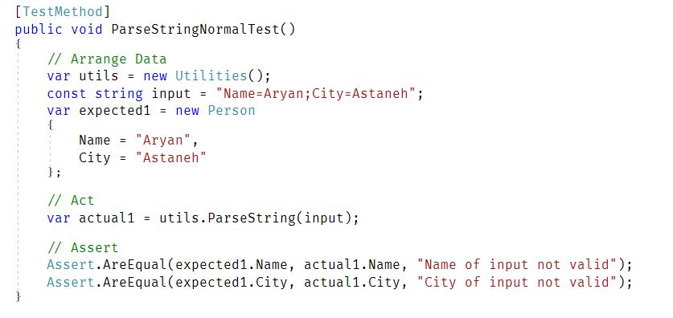
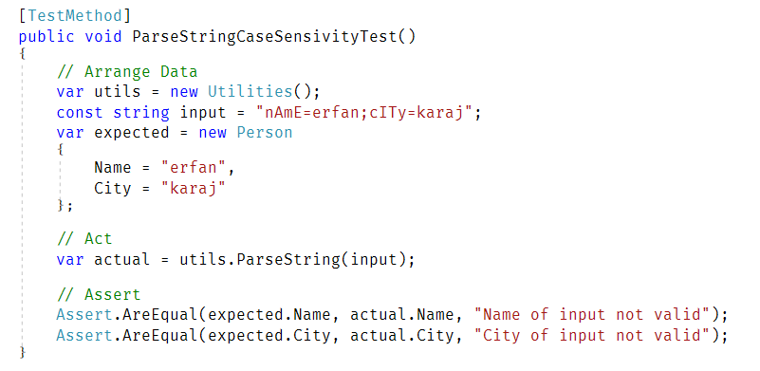
Basic Example (14), Split Test Methods

Slide 20
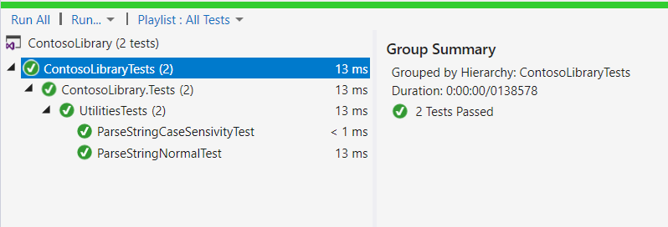
Basic Example (15), Split Test Methods
And there will be 2 tests in the Test Explorer

Slide 21

Real World Examples
Let’s check out GitHub for some popular projects

Slide 22

Newtonsoft Json .NET
Most popular Nuget package in .NET ecosystem

Slide 23
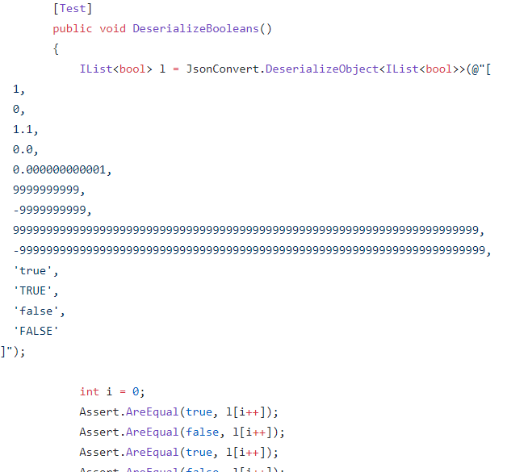
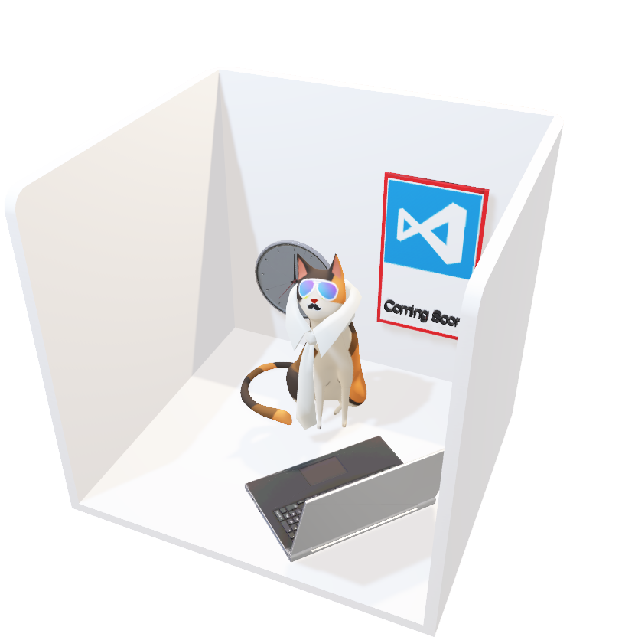
Newtonsoft Json .NET

Slide 24
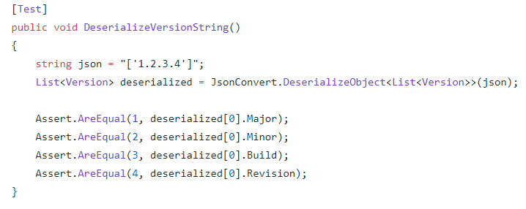
Newtonsoft Json .NET

Slide 25
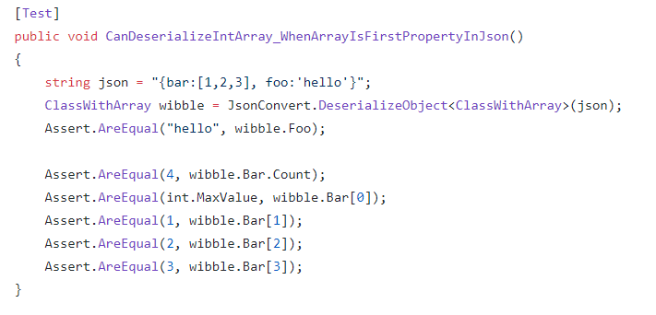
Newtonsoft Json .NET

Slide 26
Newtonsoft Json .NET

Slide 27

Microsoft C# Language
Roslyn tests for C# Language

Slide 28
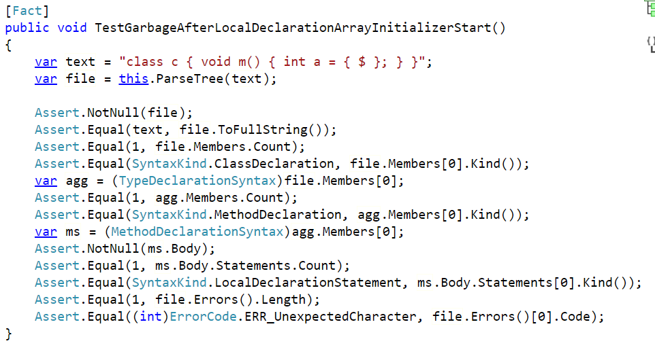
Microsoft C# Language

Slide 29
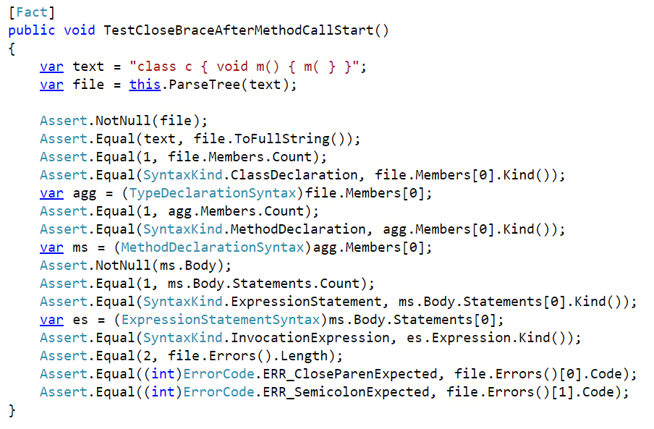
Microsoft C# Language

Slide 30
Behavior-driven Development
Or simply BDD

Slide 31
BDD
Emerged from TDD (or Test-driven Development)
Express the behavior and the expected outcomes

Slide 32
BDD
Scenario 1: Refunded items should be returned to stock
Given that a customer previously bought a black sweater from me
And I have three black sweaters in stock.
When they return the black sweater for a refund
Then I should have four black sweaters in stock.
Story: Returns go to stock
As a store owner
In order to keep track of stock
I want to add items back to stock when they're returned.
Scenario 2: Replaced items should be returned to stock
Given that a customer previously bought a blue garment from me
And I have two blue garments in stock
And three black garments in stock.
When they return the blue garment for a replacement in black
Then I should have three blue garments in stock
And two black garments in stock.
Notes:
ژاکت

Slide 33
Brittle/Fragile Tests
Tests that are easy to break

Slide 34
Brittle/Fragile Tests
Things that make unit tests brittle:
Assert against elements in UI
Asserting against large result strings instead of small ones
Static states shared between threads
Unrealistic test data
Brittle code under test
Too many responsibilities
Tests whose results can vary based on the environment, such as performance timings.
Tests that can't run independently of each other.

Slide 35
References

Slide 36
References
Robert E. Filman; Tzilla Elrad; Siobhán Clarke; Mehmet Aksit (2004). Aspect-Oriented Dependency Management
Anastasios Manessis, Adrian Hilton, Phil McLauchlan and Phil Palmer (2000). "A Statistical Geometric Framework for Reconstruction of Scene Models"
Virginia Postrel (1999). "Power fantasies: the strange appeal of the Y2K bug – Year 2000 transition problem“
Roger S. Pressman, Software Engineering: A Practitioner’s Approach, 7/e
https://github.com/JamesNK/Newtonsoft.Json
http://source.roslyn.io
http://url.aryan.software/TestRef_BDD

Slide 37
Thank you!

